Slide 1
Beyond PowerPoint Presentations
Welcome. I am honored you chose to come to this session!
Julie Lien, MEd.
www.learnwithlien.com
@boots2lien
jlien@sdale.org
Notes:
This template can be used as a starter file for presenting training materials in a group setting.
Sections
Right-click on a slide to add sections. Sections can help to organize your slides or facilitate collaboration between multiple authors.
Notes
Use the Notes section for delivery notes or to provide additional details for the audience. View these notes in Presentation View during your presentation.
Keep in mind the font size (important for accessibility, visibility, videotaping, and online production)
Coordinated colors
Pay particular attention to the graphs, charts, and text boxes.
Consider that attendees will print in black and white or grayscale. Run a test print to make sure your colors work when printed in pure black and white and grayscale.
Graphics, tables, and graphs
Keep it simple: If possible, use consistent, non-distracting styles and colors.
Label all graphs and tables.

Slide 2
Introductions
Name
Position
District/School
Significant learning so far at the conference

Slide 3
The Overview
In this session you will have the opportunity to explore three different presentation options that can be added easily and effectively to your current repertoire.
We will focus on ThingLink, Adobe Spark, (formerly Adobe Voice), and Nearpod.
As each have different features and applications, we will explore ways these tools can be utilized increase engagement and the interactive nature of our instruction.
Notes:
Give a brief overview of the presentation. Describe the major focus of the presentation and why it is important.
Introduce each of the major topics.
To provide a road map for the audience, you can repeat this Overview slide throughout the presentation, highlighting the particular topic you will discuss next.

Slide 4
Specifically addressing Springdale educators, today is also about increasing student engagement with our Race to the Top grant funding that provided the 1 to 1 technology for all students Kinder through 12th grade.
Notes:
This is another option for an Overview slides using transitions.

Slide 5
ThingLink
ThingLink is a platform where an image becomes completely interactive allowing the creator to embed text, music, video, and web links to illustrate concepts or tell a story.
Notes:
Use a section header for each of the topics, so there is a clear transition to the audience.

Slide 6
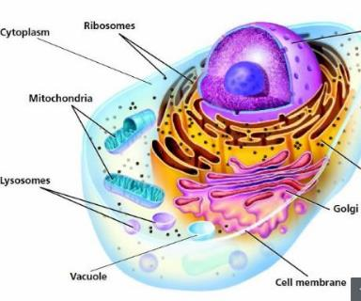
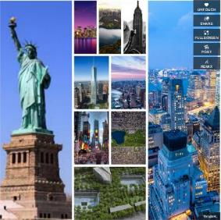
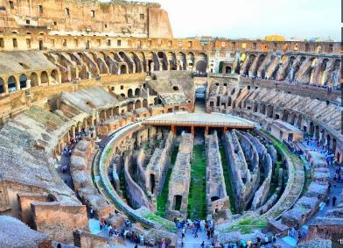
Examples of ThingLinks
Notes:
Add slides to each topic section as necessary, including slides with tables, graphs, and images.
See next section for sample table, graph, image, and video layouts.

Slide 7
Getting started:
Go to www.thinglink.com
Click join in upper right corner
Use Google+, Twitter, or Facebook
Navigation:
Stream-find people or search topics
Browse-touch to add existing Thinglink to My Stuff (Remix allows you to now “own” and adjust an existing image
Create-make a unique interactive image

Slide 8
Everything ThingLink
starts with an image…
Select & upload image
Image appears in editing mode
Title the image
Add content to make your image interactive by imbedding images, links, text, audio, or anything with a URL-including videos.
Click to add tag. The edit tag dialogue box opens on left.
Select the tag icon options-top right of dialogue box
Paste link or image address
Choose image size
Add descriptive text
Tag styling
Save tag
5 Tips for ThingLink Tags & Rich Media Tag Options

Slide 9
Saving and Sharing Your ThingLink
Now that your image is complete,
click save image bottom right of the screen.
Edit Image
Touch to save to My Stuff
Share
View full Screen
Post to Channel
Notes:
What will the audience be able to do after this training is complete? Briefly describe each objective how the audience will benefit from this presentation.

Slide 10
Notes:
Use a section header for each of the topics, so there is a clear transition to the audience.

Slide 11
On May 20th, Adobe launched a rebranding of three separate mobile app products. These 3 products merged into one web platform product now called Adobe Spark. (Although all three are still available as iOS apps.) So now…. Adobe Slate - Adobe Spark Page Adobe Post - Adobe Spark Post Adobe Voice - Adobe Spark Video
Notes:
Add slides to each topic section as necessary, including slides with tables, graphs, and images.
See next section for sample table, graph, image, and video layouts.

Slide 12
Getting started:
Go to https://spark.adobe.com/
Notice the navigation parts of
the launch page
My Projects
Inspiration Gallery
Blog

Slide 13
Inspiration Gallery:
Select a category under #SparksMade
Inspirations are available for a variety of categories.
Based on your category, the inspirations shown will be examples of Posts, Pages, and Videos.

Slide 14
Inspiration Gallery:
Post – a single graphic/photo with text (Banner example)
http://www.learnwithlien.com/reading-links.html
Type text for your image and select a graphic size (social media)
You are presented with an option for how your text could look over a photo
To change the photo select replace.
You may upload photo file from your computer or select from the 5 other photo selection options.
Your text now appears on your photo.
Navigation upper right
Resize, Theme, Palette, Photo, and Text
Toggle through these options to personalize your post.
Share in center (share or download)

Slide 15
Inspiration Gallery:
Page - a web page creation product to share a story/idea on the web
Photography Perspective Example
Use photos, text and video
Title the page and select a primary background photo
Prompted to add photo, text, links, video, photo grid or glideshow to add content to the web page
The page can be as long as the author desires to cover the content.
As the page is viewed photos can be scrolling windows, screen width, centered or uploaded as a grid of images.
Preview and Share at the top center (create link)
Student reports or research can be an excellent use of this product.

Slide 16
Inspiration Gallery:
C. Video – Pictures, text and your voice with background music
Title your story and select a theme/template
Promote an Idea, Tell What Happened, A Hero’s Journey, Show and Tell, Teach a Lesson….
These themes are helpful by suggesting what could be entered next in the video product
Navigation in upper right: Theme, Music, Layout to meet your story telling needs
Begin with an image or even an image with text
Narrate the message for that image (Remembered to hold mic button down as you record your voice and for a bit longer when finished talking.)
Add the next image with narration until you have created your whole message.
You can rerecord each page as many times as needed
Final product is a seamless video story with your narration, including images to support your message with pleasant background music. The music is part of the theme or can be changed.
Preview, Share, or download
Personal example for J.Lien

Slide 17
Nearpod is an interactive presentation platform. The creator can upload an existing PowerPoint that can then be modified to embed quizzes, polls, videos, images, drawing-boards, open-ended responses at strategic points in the lesson. The teacher/facilitator is able to capture these responses in real time, select certain ones to display as examples, or show a graph of responses gathered. All responses are captured and retained for the teacher/facilitator to review after the presentation as formative data.
Notes:
Use a section header for each of the topics, so there is a clear transition to the audience.

Slide 18
Getting started:
Go to https://nearpod.com
Notice parts of the launch page
Center buttons
Create a Teacher Account
Enter PIN to join a Lesson
The upper right corner has a button where you will log in after you create the free account
Use may use Google/school email account information

Slide 19
Navigating Nearpod
Your presentations
Search for existing presentations (Filter for price, grade, CCSS, and subject
Join a lesson as a participant
Create your own from scratch or upload existing PPT
Assessment and participation data saved from embedded activities
Notes:
What will the audience be able to do after this training is complete? Briefly describe each objective how the audience will benefit from this presentation.

Slide 20
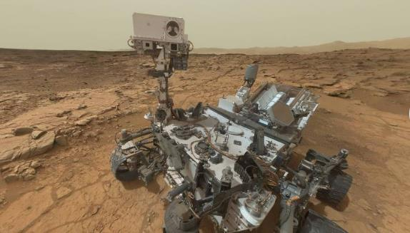
Examples
Purchased from Nearpod
I created this by uploading a ppt
Free from Nearpod 360
Notes:
Add slides to each topic section as necessary, including slides with tables, graphs, and images.
See next section for sample table, graph, image, and video layouts.

Slide 21
Nearpod in 4 Steps…
Notes:
Keep it brief. Make your text as brief as possible to maintain a larger font size.

Slide 22
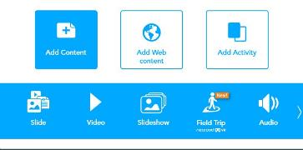
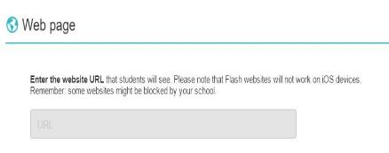
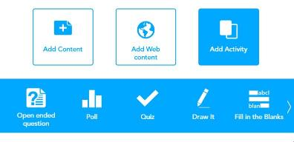
Modify Lesson & Add Slide

Slide 23
Let’s Make One Together

Slide 24
Specifics to Multi-Media Slides
Add slide, Add Content
To any slide you can add text, images, and/ or audio
Images - many options – many file types accepted
Search Images – click add
Add audio - cannot record audio with Nearpod, just use a smart phone or app like Audacity
Add video - several sources including YouTube accepted or use a link with web share
Add Draw It - This is Nearpod’s version of an interactive whiteboard. Drag image or use a pdf then pose a question and ask students to mark the image based on the prompt.

Slide 25
Tips
Virtual Field trips:
Type into Nearpod omni bar a search for Virtual Field Trips
The Mars - Virtual Tour of the Ted Planet is one example
Nearpod partnered with 360 Cities to create these experiences
Add “On the Fly” activites like pre and post thought provoking questions to prompt and guide discussions
Organize your My Library:
My Library, +new, add folder, name it and create
Move lessons into the folder for easy location later
This sorting function is available with the three dots in the upper right as well…add folder

Slide 26
Final Thoughts
Publishing Options:
Teacher paced - live session
Student paced - individually paced
Turn Google Slides into a Nearpod
Nearpodize This is a Chrome Extension that allows you to launch a Nearpod lesson or edit to add activities
Nearpod is also an app for Chrome 4
On the Fly Features:
Teachable moment…add activity when it finishes, select close and presentation picks up where you left off

Slide 27
Session Summary
We have explored three different presentation options designed to increase engagement and the interactive nature of our instruction.
ThingLink is a web-based platform where an image becomes completely interactive allowing the creator to embed text, music, video, and web links to illustrate concepts or tell a story.
Adobe Spark is a merging of three iOS apps into one dynamic web based platform.
Post - Utilizes a single graphic/photo with superimposed text
Page - A web page creation product to share a story/idea on the web
Video - Use pictures, text and your voice with background music to tell a story or share an idea
Nearpod is an interactive web-based, interactive presentation platform.
The author embeds quizzes, polls, videos, images, drawing-boards, open-ended responses at strategic points in the lesson.
The teacher/facilitator is able to capture these responses in real time and select certain ones to display as examples or show a graph of responses gathered.
All responses are captured and retained for the teacher/facilitator to review after the presentation as formative data.
Notes:
Summarize presentation content by restating the important points from the lessons.
What do you want the audience to remember when they leave your presentation?
Save your presentation to a video for easy distribution (To create a video, click the File tab, and then click Share. Under File Types, click Create a Video.)

Slide 28
Resources for Ongoing Support
ThingLink Help Center
Nearpod Help Center
Adobe Spark Help Center
jlien@sdale.org

Slide 29
Questions?

